Slide 1
Discrete Mathematics
Xiaowei Yang
School of Software Engineering
South China University of Technology
Office Room: B7-218
E-Mail Address: xwyang@scut.edu.cn

Slide 2
Contents
Contents of Discrete Mathematics
Chapter 1 The Foundations: Logic and Proofs
Chapter 2 Basic Structures: Sets, Functions, Sequences, and Sums
Chapter 3 Counting
Chapter 4 Advanced Counting Techniques
Chapter 5 Relations
Chapter 6 Graphs
Chapter 7 Trees

Slide 3
Chapter 1. The Foundations :Logic and Proofs

Slide 4
Contents of the Chapter 1
1.1 Propositional Logic
1.2 Propositional Equivalences
1.3 Predicates and Quantifiers
1.4 Nested Quantifiers
1.5 Rules of Inference
1.6 Introduction to Proofs
1.7 Proof Methods and Strategy

Slide 5
Contents
1
Propositions
2
Implications
3
Precedence of Logical Operators
4
Translation
5
Application Examples

Slide 6
Propositions

Slide 7
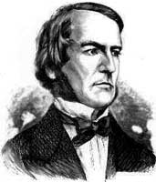
Propositional Logic (§1.1)
Propositional Logic is the logic of compound statements built from simpler statements
using so-called Boolean connectives.
Some applications in computer science:
Design of digital electronic circuits.
Expressing conditions in programs.
Queries to databases & search engines.
George Boole
(1815-1864)

Slide 8
Propositions in natural language
In propositional logic, a proposition is simply:
a sentence that declares a fact
  with some definite meaning
having a truth value that’s either true (T) or false (F)
  Never both, or somewhere “in between”. However, you might not know the
  truth value

Slide 9
Examples of NL Propositions
“It is raining.” (In a given situation.)
“Beijing is the capital of China, and 1 + 2 = 2”
But, the following are NOT propositions:
“Who’s there?” (interrogative: no truth value)
“x = y+1” (rule: no truth value)
“1 + 2” (term: no truth value)

Slide 10
Some Popular Boolean Operators
Formal Name | Nickname | Arity | Symbol
Negation operator | NOT | Unary | ¬
Conjunction operator | AND | Binary | ∧
Disjunction operator | OR | Binary | ∨
Exclusive-OR operator | XOR | Binary | ⊕
Implication operator | IMPLIES | Binary | →
Biconditional operator | IFF | Binary | ↔

Slide 11
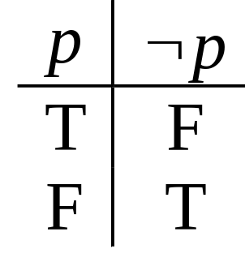
The Negation Operator
The unary negation operator “¬” (NOT) transforms a propositon into its negation.
E.g. If p = “I have brown hair.”
then ¬p = “I do not have brown hair.”
The truth table for NOT:
T :≡ True; F :≡ False
“:≡” means “is defined as”
Operand
column
Result
column

Slide 12
The Conjunction Operator
The binary conjunction operator “∧” (AND) combines two propositions to form their logical conjunction.
E.g. If p=“I will have salad for lunch.” and q=“I will have steak for dinner.”, then p∧q=“I will have salad for lunch and
I will have steak for dinner.”

Slide 13
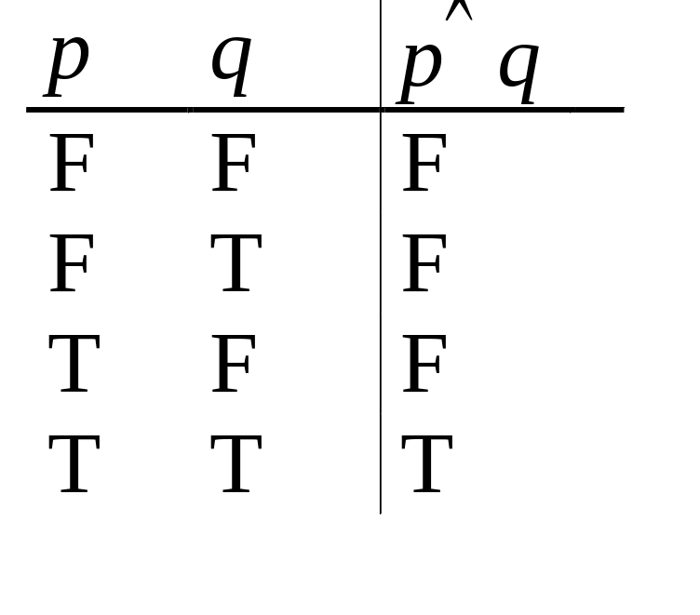
Conjunction Truth Table
Note that a
conjunction
p₁ ∧ p₂ ∧ … ∧ p_{n}
of n propositions
will have 2^{n} rows
in its truth table.
Also: ¬ and ∧ operations together are sufficient to express any Boolean truth table!
Operand columns

Slide 14
The Disjunction Operator
The binary disjunction operator “∨” (OR) combines two propositions to form their logical disjunction.
p=“My car has a bad engine.”
q=“My car has a bad carburetor.”
p∨q=“Either my car has a bad engine, or
my car has a bad carburetor.”

Slide 15
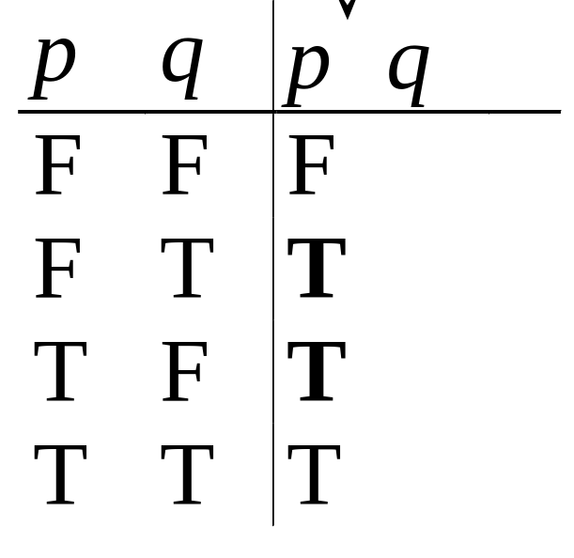
Disjunction Truth Table
Note that p∨q means
that p is true, or q is
true, or both are true!
So, this operation is
also called inclusive or,
because it includes the
possibility that both p and q are true.
“¬” and “∨” together are also universal.
Note
difference
from AND

Slide 16
The Exclusive Or Operator
The binary exclusive-or operator “⊕” (XOR) combines two propositions to form their logical “exclusive or”.
p = “I will earn an A in this course,”
q = “I will drop this course,”
p ⊕ q = “I will either earn an A in this course, or I will drop it (but not both!)”

Slide 17
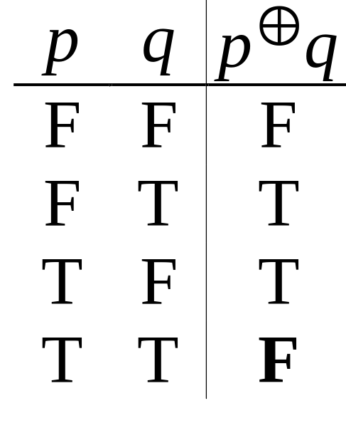
Exclusive-Or Truth Table
Note that p⊕q means
that p is true, or q is
true, but not both!
This operation is
called exclusive or,
because it excludes the
possibility that both p and q are true.
“¬” and “⊕” together are not universal.
Note
difference
from OR.

Slide 18
Test your understanding of the two types of disjunction
Suppose p ∨ q is true.
Does it follow that p⊕q is true?
Suppose p⊕q is true.
Does it follow that p ∨ q is true?

Slide 19
Test your understanding of the two types of disjunction
Suppose p ∨ q is true.
Does it follow that p⊕q is true?
No: consider p TRUE, q TRUE
Suppose p⊕q is true. Does it follow
that p ∨ q is true? Yes. Check each
of the two assignments that make p⊕q true:
a) p TRUE, q FALSE (makes p ∨ q true)
b) p FALSE, q TRUE (makes p ∨ q true)

Slide 20
Implications

Slide 21
The Implication Operator
antecedent
consequent
The implication p → q states that p implies q.
I.e., If p is true, then q is true; but if p is not true, then q could be either true or false.
E.g., let p = “You study hard.”
q = “You will get a good grade.”
p → q = “If you study hard, then you will get a good grade.”

Slide 22
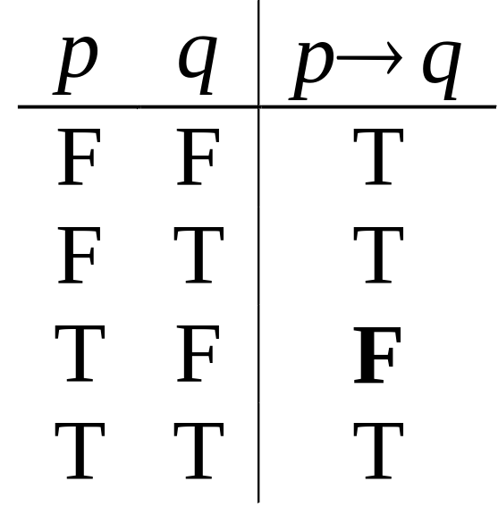
Implication Truth Table
p → q is false only when
(p is true but q is not true)
p → q does not mean
that p causes q!
p → q does not require
that p or q are true!
The
only
False
case!

Slide 23
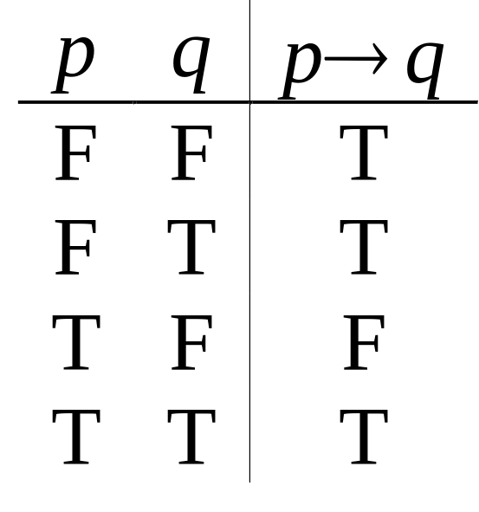
Implication Truth Table
Suppose you know
that q is T. What
do you know about
p→q ?

Slide 24
Implication Truth Table
Suppose you know
that q is T. What
do you know about
p→q ?
The conditional
must be T

Slide 25

Implication Truth Table
Suppose you know
that p is F. What
do you know about
p→q ?
The conditional
must be T

Slide 26
Implications between real sentencs
“If this lecture ever ends, then the sun has risen this morning.” True or False?
“If Tuesday is a day of the week, then I am Andy Lau.” True or False?
“If 1+1=6, then Bush is president.”
True or False?
“If the moon is made of green cheese, then I am richer than Bill Gates.” True or False?

Slide 27
English Phrases Meaning p → q
“p implies q”
“if p, then q”
“if p, q”
“when p, q”
“whenever p, q”
“q if p”
“q when p”
“q whenever p”
“p only if q”
“p is sufficient for q”
“q is necessary for p”
“q follows from p”
“q is implied by p”

Slide 28
Contrapositive
Some terminology, for an implication p → q:
Its converse is: q → p.(逆命题)
Its Inverse: ¬ p → ¬ q.（反命题）
Its contrapositive: ¬q → ¬ p.（逆反命题）
Which of these three has/have the same meaning (express same truth function)
as p → q? Prove it.

Slide 29
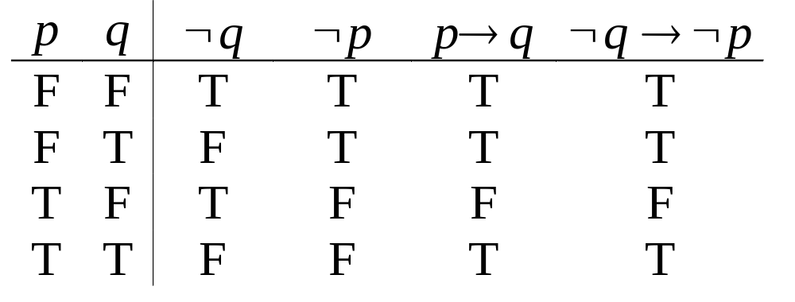
Proving the equivalence of p → q and its contrapositive, using truth tables:

Slide 30
But we’re not studying English ..
Probably no two of these expressions have exactly the same meaning in English
For example,
‘I’ll go to the party if Mary goes’
can be interpreted as implying
‘I’ll only go to the party if Mary goes’
turning the sentence into a biconditional:
I go IFF Mary goes

Slide 31
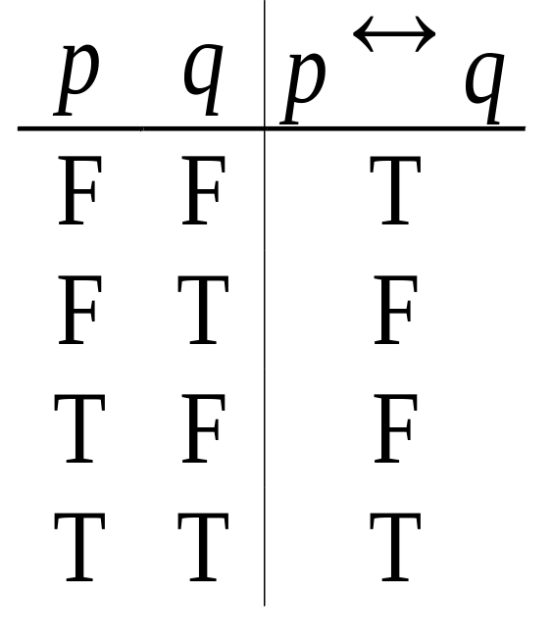
Biconditional Truth Table
p ↔ q means that p and q
have the same truth value.
Note this truth table is the
exact opposite of ⊕’s!
  Thus, p ↔ q means ¬(p ⊕ q)
p ↔ q does not imply
that p and q are true,
or that either of them causes the other.

Slide 32
Consider ...
The truth of p ↔ q, where
p= Guangzhou is in China
q= 2+2 =4
p= Japan is not in Asia
q= 2+2 =5
p= Scotland is in the UK
q= Wales is not in the UK

Slide 33
Consider ...
The truth of p ↔ q, where
p= Guangzhou is in China
q= 2+2 =4 TRUE
p= Japan is not in Asia
q= 2+2 =5 TRUE
p= Scotland is in the UK
q= Wales is not in the UK FALSE

Slide 34
Precedence of Logical Operators

Slide 35
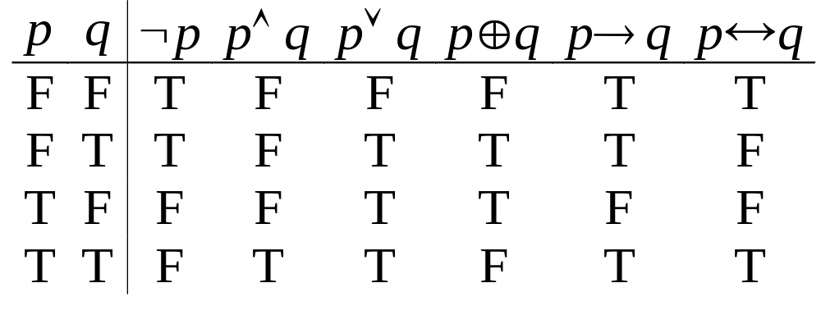
Boolean Operations Summary
We have seen 1 unary operator and 5 binary operators:

Slide 36
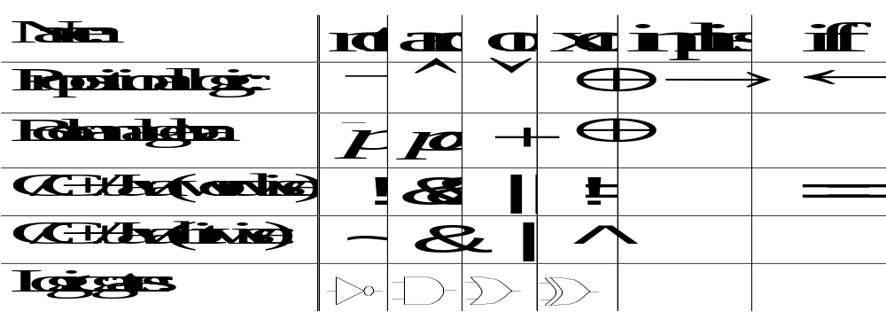
Some Alternative Notations

Slide 37
Precedence of Logical Operators
↔
→
∨ ⊕
First Direction
∧
¬

Slide 38
Translations

Slide 39
Example 1
“I just saw my old friend, and either he’s grown or I’ve shrunk.”
Solution:
Let f represent “I just saw my old friend”.
Let g represent “he’s grown ”.
Let s represent “I’ve shrunk”.
The sentence can be represented as f ∧ (g ∨ s).
  (f ∧ g) ∨ s would mean something different.

Slide 40
Example 2
Solution:
Let r =“The lawn was wet this morning”,
p =“It rained last night”,
q =“The sprinklers came on last night”.
Thus, ¬p = “It didn’t rain last night.”
r ∧ ¬p = “The lawn was wet this morning, and
it didn’t rain last night.”
The sentence can be represented as ¬ r ∨ p ∨ q
“Either the lawn wasn’t wet this morning, or it rained last night, or the sprinklers came on last night.”

Slide 41
Example 3
“You cannot ride the roller coaster if you are under 4 feet tall unless you are older than 16 years old.”
Solution:
Let q = “You can ride the roller coaster ”,
r = “you are under 4 feet tall ”,
s = “you are older than 16 years old”.
The sentence can be represented as
(¬ s ∧ r) →¬ q

Slide 42
Example 4
Express the specification “The automated reply cannot be sent when the file system is full” using logical connectives.
Solution:
Let p denote “The automated reply can be sent ”,
and q denote “the file system is full”.
The sentence can be represented as
q → ¬p

Slide 43
Applications

Slide 44
Example 1: Logic Puzzle
Knight
Knave
Tell the truth
Lie
A: ”B is a Knight”
B: ”The two of us are opposite types”
A
B
A
B
A
B
A
B

Slide 45
Example 2: Muddy Forehead Children
Boy’s answer
Girl’s answer
Father
No
No
Yes
Yes
At least one of you has a muddy forehead.
Do you know whether you have a muddy forehead?
Do you know whether you have a muddy forehead?

Slide 46
Example 3: Logic and Bit Operations
XOR
1010101011
0100010100
0110110110
1100011101
AND
OR
1110111111

Slide 47
比赛名次预测
三人估计比赛结果，
甲说“A第一，B第二”。
乙说“C第二，D第四”。
丙说“A第二，D第四”。
结果三人的预测都只对了一半，请问A,B,C,D的比赛名次。

Slide 48
比赛名次预测
三人估计比赛结果，
甲说“A第一，B第二”。
乙说“C第二，D第四”。
丙说“A第二，D第四”。
结果三人的预测都只对了一半，请问A,B,C,D的比赛名次。
构造真值表来表示三人的预测结果，理论上真值表总共有2*2*2=8行（每个人的预测结果是TF或者FT）。
比赛的名次（从第一到第四）是C,B,A,D，每个人的预测都错了前一半，对了后一半。

Slide 49
Exercises
P14 6. b)
P15 15. e)
助教：
电话：

Slide 50
End of the 1.1 Logic
Click to edit company slogan .

